Slide 1

Team Name : Kalgen
Team Leader Name : Anaj Rajeev
Problem Statement : Indian farmers suffer income loss and crop risk due to fragmented information, language barriers, lack of trusted market access, and middlemen dominance, preventing timely decisions, fair pricing, and effective use of government support.

Slide 2
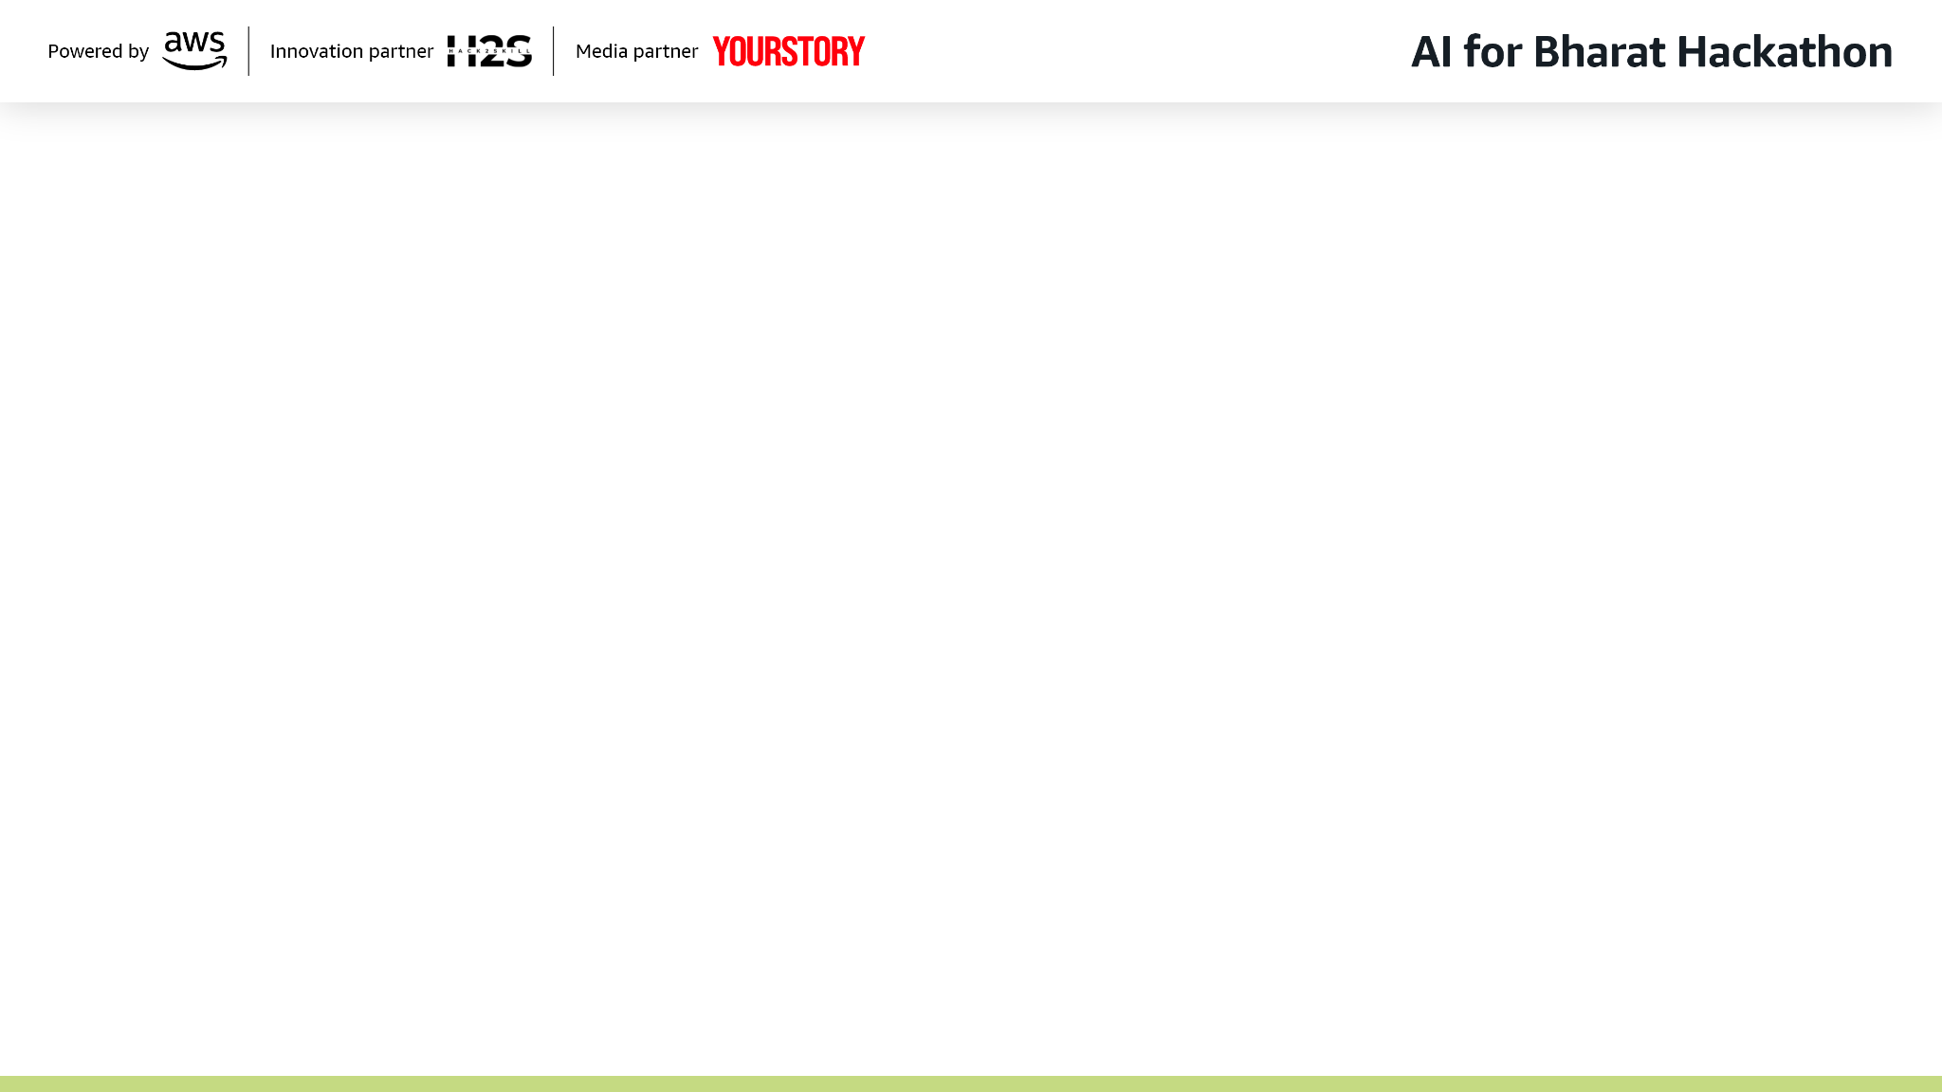
Brief about the Idea:
This solution is a unified AI-powered agricultural platform that enables farmers to make better farming decisions and sell their produce at fair prices through one simple system. Farmers interact using voice, text, or images in their local language, while the platform provides real-time AI advisory such as crop and soil analysis, weather and yield predictions, disease detection, and government scheme guidance. To ensure fair trade, the platform translates and enables communication across different languages in real time, allowing farmers and buyers from different regions or states to negotiate directly without language barriers, thereby eliminating middlemen. By combining multilingual AI advisory, trusted buyer–seller matching, transparent pricing, and logistics intelligence into a single ecosystem, the platform increases farmer income, reduces crop loss and fraud, and enables scalable, sustainable, and borderless rural commerce. Ultimately, it empowers farmers with fair prices, timely information, and trusted access to markets, while building a transparent, sustainable, and inclusive rural agricultural ecosystem.

Slide 3
Solution explained
How different is it from any of the other existing ideas?
Existing platforms solve either advisory or marketplace, this integrates both decision-making and selling in one system.
Unlike text-heavy apps, it is voice-first, image-enabled, and real-time multilingual, built for low-literacy users.
It replaces blind matchmaking with AI-based trust ranking, verification, and price intelligence.
How will it be able to solve the problem?
Farmers receive predictive, personalized guidance (crop, weather, schemes) before losses occur.
Real-time language translation allows direct negotiation with verified buyers across regions, removing middlemen.
AI-driven trust checks, pricing, and logistics ensure fair, transparent, and safe transactions.
USP of the proposed solution
End-to-end AI ecosystem: advisory + trusted marketplace in one platform.
Voice-first, multilingual, multimodal AI designed for real rural usage.
Trust re-ranking engine + real-time translation enabling fair, borderless agricultural trade.

Slide 4
List of features offered by the solution
Voice-first interaction in local languages
Real-time translation across multiple Indian languages for buyer–seller communication
Multimodal input support (voice, text, images)
AI-based crop disease and soil condition detection using images
Weather, yield, flood, and drought prediction alerts
Personalized crop and farming recommendations
Government scheme discovery, eligibility checks, and guided application support
Verified buyer–seller matching using AI trust ranking
Middleman-free price discovery with real-time market price intelligence
GST, transaction, and image-based verification to reduce fraud
Logistics and transport optimization suggestions
Transparent deal tracking and transaction history
Region-specific insights based on local trends and demand signals
Scalable, API-driven architecture for multi-state and cross-border expansion

Slide 5
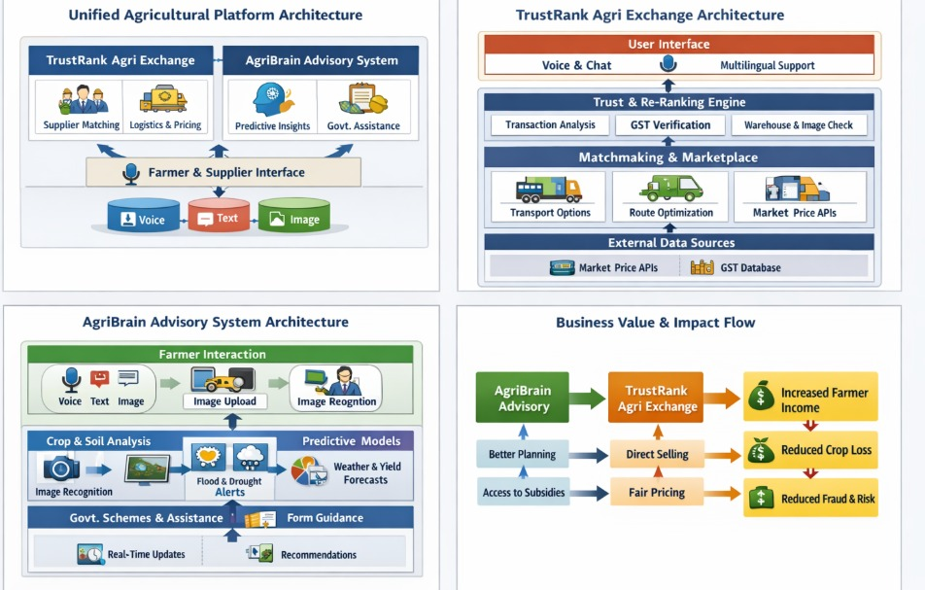
Process flow diagram or Use-case diagram

Slide 6
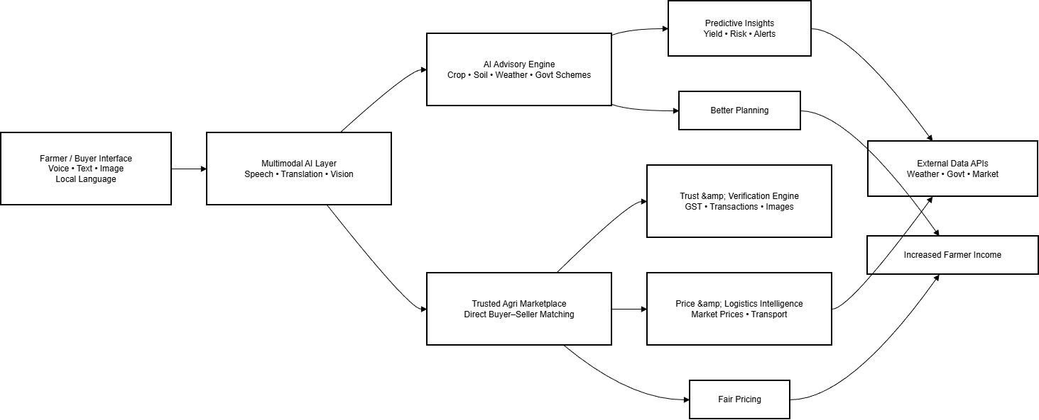
Architecture diagram of the proposed solution:

Slide 7
Technologies to be used in the solution:
Frontend: React JS, TypeScript, Offline caching, low-bandwidth optimization.
Backend & APIs: FastAPI (Python), REST + optional GraphQL, Docker, Bedrock Agents.
AI & Machine Learning: PyTorch / TensorFlow (core open-source models), Amazon SageMaker (optional large-scale training & inference), Predictive & trust-ranking models.
LLM: Bedrock Multi Models(SLM and LLM) & Embedding Models
Computer Vision: OpenCV, Amazon Rekognition.
Speech & Translation: Amazon Transcribe, Amazon Polly, Amazon Translate.
Data & Storage: PostgreSQL, Amazon OpenSearch, Amazon S3 (images, documents, audio).
Real-Time Events & Messaging: Amazon EventBridge, AWS SNS, AWS SQS.
External Data Integrations: Weather APIs, market price feeds, government portals.

Slide 8
Beneficiaries
Primary Beneficiaries
Farmers: Higher income, reduced risk, better decision-making, and easier access to markets and schemes.
Buyers/Suppliers: Verified sourcing, reduced fraud, faster procurement, and transparent pricing.
Secondary Beneficiaries
Government & Institutions: Higher scheme adoption, better data visibility, reduced leakage.
Rural Ecosystem: Stronger local markets, improved food supply stability, and inclusive growth.

Slide 9


